Slide 1

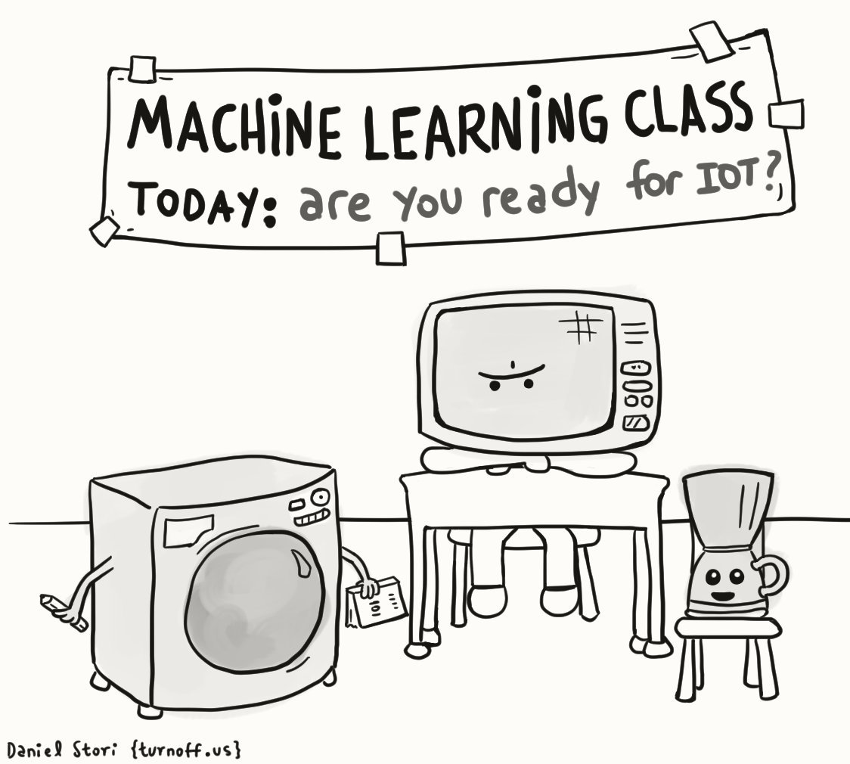
JACS: Intro to Machine Learning
Hayden Rampadarath
13th November 2017

Slide 2
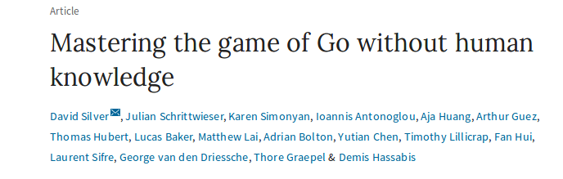
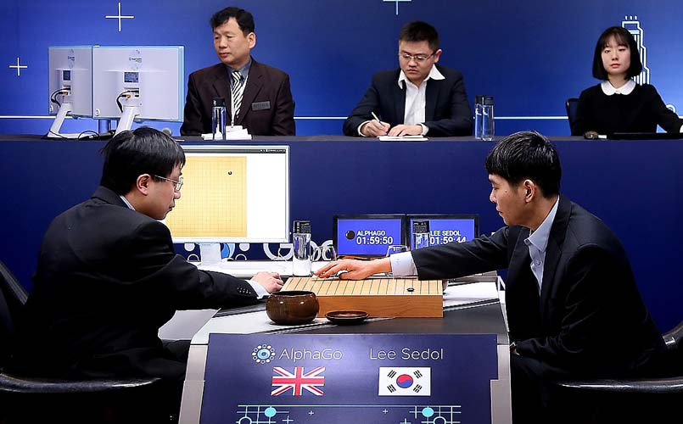
https://www.nature.com/articles/nature24270
“Here we introduce an algorithm based solely on reinforcement learning, without human data, guidance or domain knowledge beyond game rules. AlphaGo becomes its own teacher … AlphaGo Zero achieved superhuman performance, winning 100–0 against the previously published, champion-defeating AlphaGo.

Slide 3
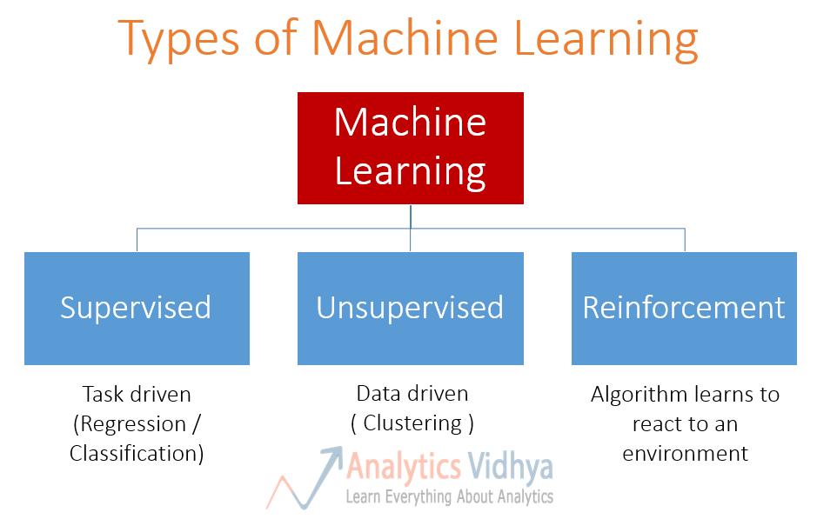
Deep Learning/
Neural Networks

Slide 4
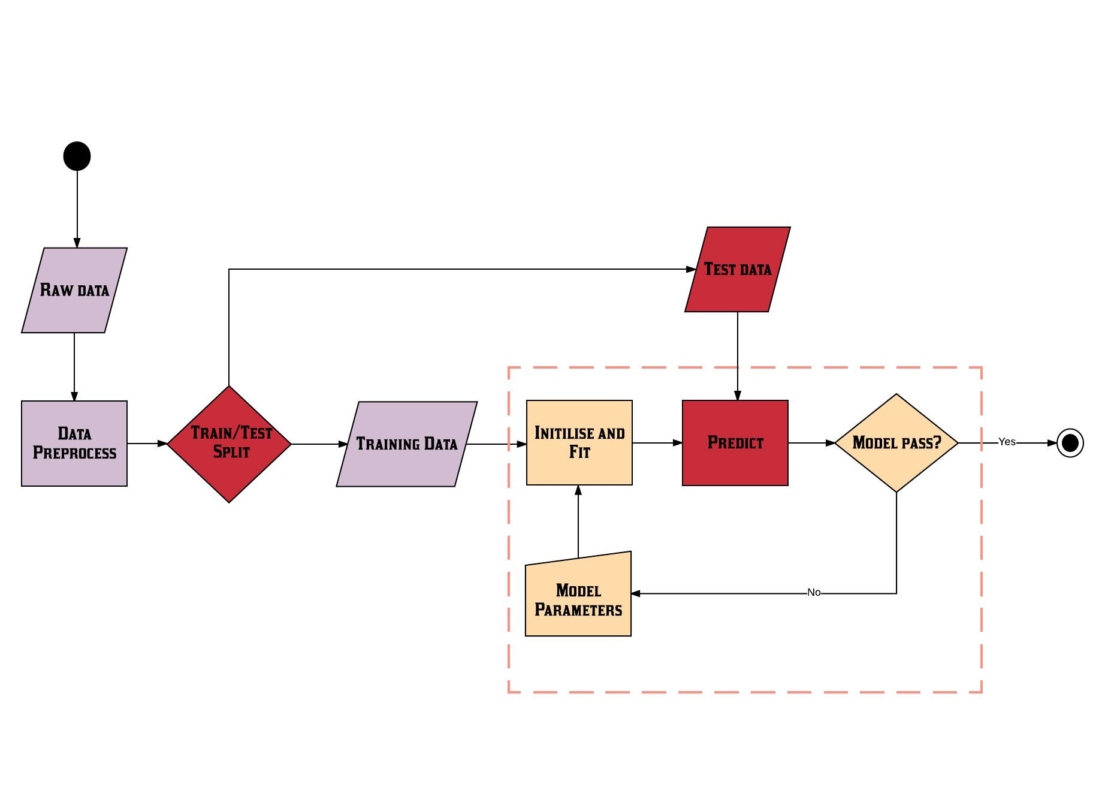
Supervised Learning - Most Common

Slide 5
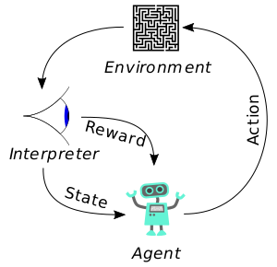
Reinforcement Learning
Diagram showing the components in a typical Reinforcement Learning (RL) system. An agent takes actions in an environment which is interpreted into a reward and a representation of the state which is fed back into the agent.
From Wikipedia and incorporates other CC0 work: https://openclipart.org/detail/202735/eye-side-view https://openclipart.org/detail/191072/blue-robot and https://openclipart.org/detail/246662/simple-maze-puzzle

Slide 6
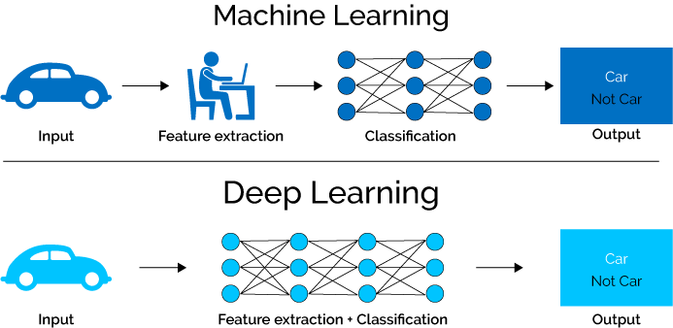
Deep Learning

Slide 7
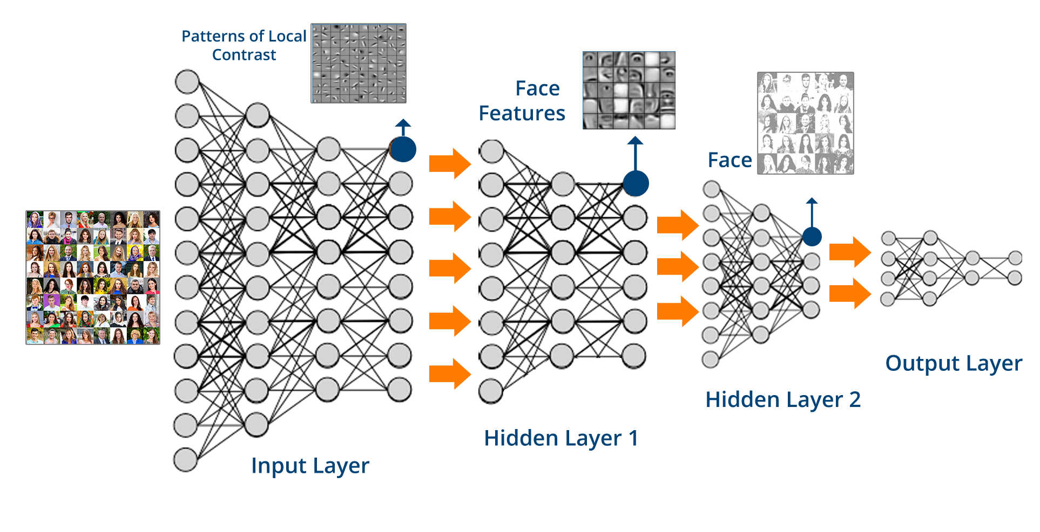
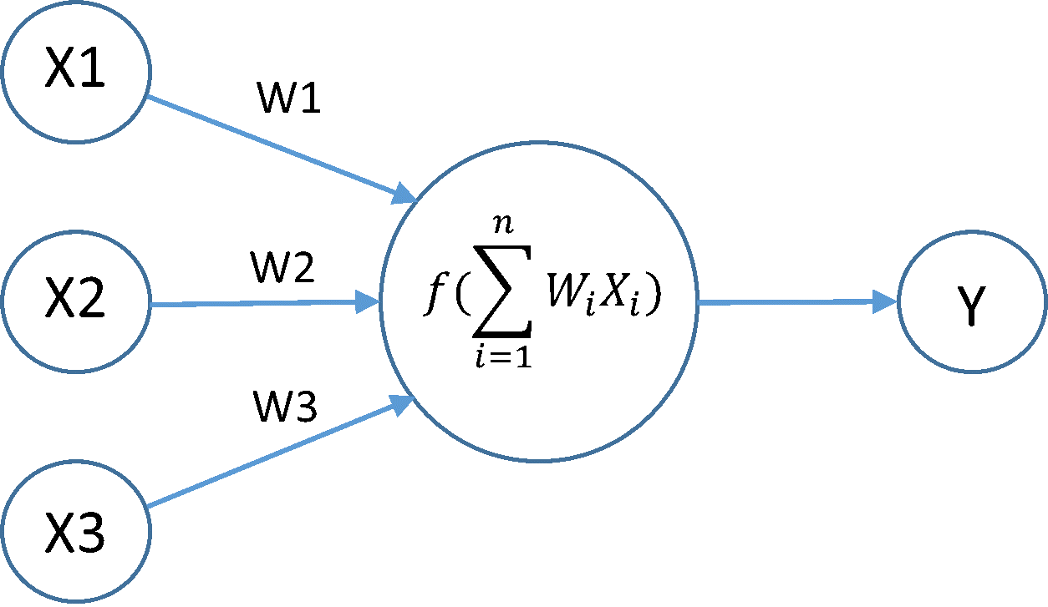
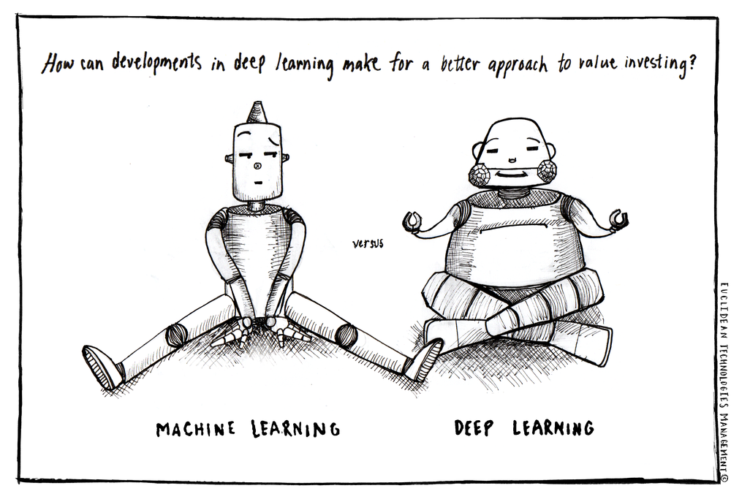
Deep Learning
Simple Neuron

Slide 8
Getting Started with Machine Learning
A quick tutorial on using Python Scikit-Learn to analyse data from the Lending Club.
The data was obtained from Kaggle [1]
Complete loan data for all loans issued through the 2007-2015, including the current loan status (Current, Late, Fully Paid, etc.) and latest payment information.
Cleaned and reduced for this tutorial.
Follow using your favourite IDE or with Jupyter Notebook
[1] https://www.kaggle.com/wendykan/lending-club-loan-data)

Slide 9
Basic ML Tutorial: 1. Load Raw Data and inspect
> import pandas as pd
> import numpy as np
# load data
> df = pd.read_csv('loans_data_cleaned.csv')
#inspect with either df.head() or df.info()
# look for null values. There should be none as I cleaned it before
>df.isnull().sum()

Slide 10
Basic ML Tutorial: 2. Some Preprocessing (1)
The goal of this exercise is to see whether we can predict someone will not pay off their loan or have become very delinquent on their payment. In this dataset it is in the 'loan_status' column.
>df.loan_status.unique() or print(df.loan_status.unique())
array(['Fully Paid', 'Late (31-120 days)', 'Late (16-30 days)',
'Charged Off', 'In Grace Period', 'Default', 'Issued'], dtype=object)
The term 'Charged Off' is the declaration by a creditor (usually a credit card account) that an amount of debt is unlikely to be collected. This occurs when a consumer becomes severely delinquent on a debt. Traditionally, creditors will make this declaration at the point of six months without payment. Thus we will be using this as our Class 1 or the positive case.

Slide 11
Basic ML Tutorial: 2. Some Preprocessing (2)
#set 'Charged Off' to 1 and the rest to 0
>mask = (df.loan_status == 'Charged Off')
>df['target'] = 0
>df.loc[mask,'target'] = 1
>target = df['target'] # here we have defined the target or the y - values
#The features or the 'X-values' will be all columns minus the 'target and loan_status' columns
>df = df.drop(['loan_status','target'],axis=1)
>print('Shape of features = {}, and of y-values = {}'.format(np.shape(df), np.shape(target)))
Shape of features = (209541, 38), and of y-values = (209541,)

Slide 12
Basic ML Tutorial: 2. Some Preprocessing (3)
#Before we could start the ML part we need to take care of the categorical features.
#first separate the categorical features from continuous columns
>loan_categorical = df.select_dtypes(include=['object'], exclude=['float64','int64'])
>features = df.select_dtypes(include=['float64','int64'])
>print('Numerical features: \n{}'.format(list(features)))
>print('Categorical features: \n{}'.format(list(loan_categorical)))

Slide 13
Basic ML Tutorial: 2. Some Preprocessing (4)
#One of the true power of ML and sklearn is the ability to use categorical data to train the model. But to do we need to convert to numerical data
>for col in list(loan_categorical):
dummy = pd.get_dummies(loan_categorical[col])
features = pd.concat([features,dummy],axis=1)
>print('Shape of features = {}, and of y-values = {}'.format(np.shape(features), np.shape(target)))
Shape of features = (209541, 865), and of y-values = (209541,)

Slide 14
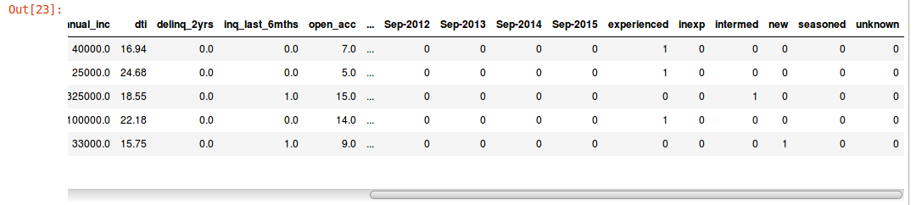
Basic ML Tutorial: 2. Some Preprocessing (4)
>features.head()

Slide 15
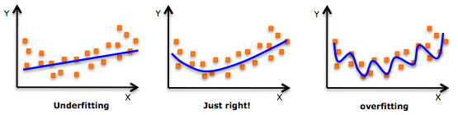
Basic ML Tutorial: 2. Train/Test Split
A fundamental part of ML is the Train/Test split.
You do not want to use all your data to develop a model, as you can overfit on the data to create a perfect model for that data with no generalisation!
Advisable to “hold” back some of the data (30%) to test your models
>from sklearn.model_selection import train_test_split
>X_train, X_test, y_train, y_test = train_test_split(features,target, random_state=0)
Image from: https://towardsdatascience.com/train-test-split-and-cross-validation-in-python-80b61beca4b6

Slide 16
Basic ML Tutorial: 3. Train some ML models
Now we can train a couple of models to determine if someone is "Charged Off" on their loan. Here’s a list of the more common ML models: note there are lots more!
1. K nearest-Neighbours (KNN) - sklearn.neighbors.KNeighborsClassifier
2. Support Vector Machines (SVM) - sklearn.svm.SVC or sklearn.svm.LinearSVC
3. Random Forests - sklearn.ensemble.RandomForestClassifier
4. Gradient Boosted Decision Trees - sklearn.ensemble.GradientBoostingClassifier
5. Logistic Regression - sklearn.linear_model.LogisticRegression

Slide 17

Basic ML Tutorial: 3. Train some ML models
You can use anyone I’ll use Logistic Regression.
>from sklearn.linear_model import LogisticRegression
>model = LogisticRegression()
>model.fit(X_train,y_train)
Yes that is it! Well not really ...

Slide 18
Basic ML Tutorial: 4. Test your ML model!
>y_pred_LR = model.predict(X_test)
>print('Accuracy of the model = {:.4f}'.format(model.score(X_test,y_test)))
Accuracy of the model = 0.9987
Oh cool the model is 99.9% accurate! Well what does that mean? Is this really reliable?
To really determine the accuracy or the predictive power of your model, there are a few more useful tools than “Accuracy”
Confusion matrix
Classification report
ROC curve (Precision and Recall curve for unbalanced datasets)
Area Under the Curve(AUC)

Slide 19
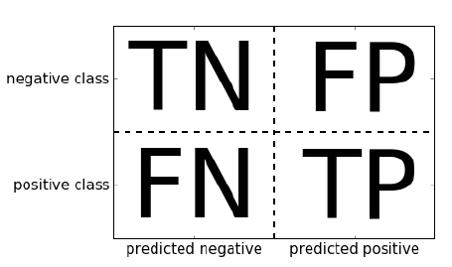
Basic ML Tutorial: 5. Does the model pass?
Confusion matrix
>from sklearn.metrics import confusion_matrix, classification_report, precision_recall_curve, average_precision_score
> print('confusion matrix:\n {}'.format(confusion_matrix(y_test,y_pred_LR)))
confusion matrix:
[[43777 1]
[ 67 8541]]

Slide 20
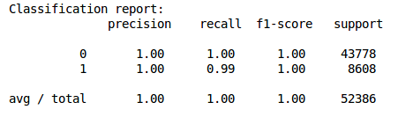
Basic ML Tutorial: 5. Does the model pass?
Classification report
> print('Classification report: \n {}'.format(classification_report(y_test,y_pred_LR)))

Slide 21
Basic ML Tutorial: 5. Does the model pass?
Precision-Recall Curve and AUC
>precision, recall, thresholds = precision_recall_curve(y_test,model.predict_proba(X_test)[:, 1])
>AUC = average_precision_score(y_test, model.predict_proba(X_test)[:, 1])
>import matplotlib.pyplot as plt
>plt.plot(precision, recall, label='AUC: {:.2f}'.format(AUC))
>plt.ylabel('Recall')
>plt.xlabel('Precision')
>plt.title('Precision-Recall Curve')
>plt.legend(loc='best')

Slide 22
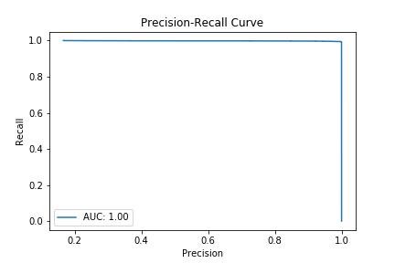
Basic ML Tutorial: 5. Does the model pass?

Slide 23

Basic ML Tutorial: 5. Does the model pass?

Slide 24
What next?
If you are interested here are some invaluable resources:
Textbooks:
  Introduction to Machine Learning with python: https://www.dropbox.com/s/9e40qzxpw8dclu3/Introduction_to_Machine_Learning_with_Python.pdf?dl=0
  An Introduction to Statistical Learning with Applications in R: http://www-bcf.usc.edu/~gareth/ISL/
  Deep Learning: http://www.deeplearningbook.org/

Slide 25
What next?
If you are interested here are some invaluable resources:
Courses:
Andrew Ng’s Coursera course (good introduction, but he dives deep into the actual ML codes)
Udemy tons of great courses and usually have sales for £10 per course
  I learned from Python for Data Science and Machine Learning Bootcamp by Jose Portilla
https://www.dataquest.io/ - a subscription fee if you want the advanced ML courses

Slide 26
What next?
If you are interested here are some invaluable resources:
Data:
Kaggle: https://www.kaggle.com/
OpenML: https://www.openml.org/search?type=data
UC Irvine Machine Learning Repository: https://archive.ics.uci.edu/ml/index.php
https://data.gov.uk/

Slide 27
What next?
If you are interested here are some invaluable resources:
ML Competitions:
https://www.kaggle.com/competitions
https://www.hackerearth.com/challenges/

